Slide 1
PROPOSED AUTOMATED QRS
28 May 2024
Notes:
CLICK ENTER(Next)

Slide 2
O B J E C T I V E S
TO PRESENT THE PROPOSED AUTOMATION OF QRS TO BE INTEGRATED IN HRMIS AND SUBSEQUENT APPROVAL OF PROPOSED TIMELINE AND POE

Slide 3
REFERENCES
BACKGROUND
SYSTEM PROCESS FLOWCHART
SYSTEM SPECIFICATIONS
PROJECT TIMELINE
POE
RECOMMENDATION
SEQUENCE OF
PRESENTATION

Slide 4
R E F E R E N C E S
CIRCULAR NR 06 DATED 22 JUNE 2021, TITLED: OFFICERS PROMOTION SYSTEM IN THE ARMED FORCES OF THE PHILIPPINES
GUIDANCE OF THE CSAFP TO THE MAJOR SERVICES TO COME UP WITH A HARMONIZED COMPUTATION OF QRS AMONG THE MS FOR PROMOTION OF O-4 TO O-6

Slide 5



B A C K G R O U N D
1. THE HIGHER HEADQUARTERS INSTRUCTED THE MAJOR SERVICES AND TAS TO ADOPT A STANDARD POINT ALLOCATION PER CRITERIA / FACTORS FOR SELECTION 2. J1 PRESENTED TO THE SND LAST 05 MAR 24 THE SALIENT POINTS ON THE PROPOSED REVISION OF CIR NR 06: OFFICER PROMOTION SYSTEM AND PROPOSED HARMONIZED MRS FOR O-4 AND O-5 AND QRS FOR O-6
3. SND’s GUIDANCE TO CHANGE GEOGRAPHICAL ASSIGNMENT IN THE PARAMETERS
4. THE CG, PAF APPROVED THE HARMONIZED QRS FOR O-4 TO O-6 ON 30 APRIL 2024
4
5
6

Slide 6
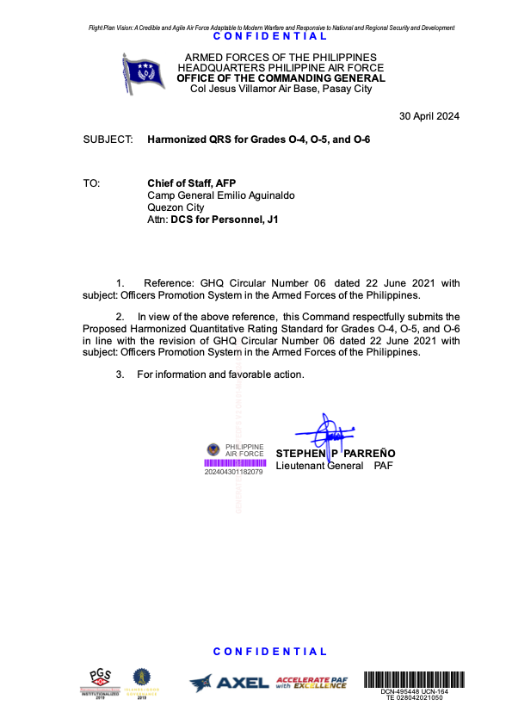

CGPAF APPROVED QRS FOR O-4 TO O-6

Slide 7





SYSTEM PROCESS FLOWCHART
2
3
1
YES
OA-1 encoder logs to HRMIS and validates encoded QRS
UNIT DP
If QRS = ‘O-6’
OA-1
PAFBOSO
PAFHRMC
PAF SELECTION BOARD
LOG-IN to HRMIS and encodes QRS
PAFHRMC encoder logs to HRMIS and validates encoded QRS
NO
Notes:
THE SYSTEM WILL START FROM ENCODING OF QRS BY UNIT DP BASED ON OFFICERS DATA FOUND IN THEIR RESPECTIVE SOI.
THE AUTOMATED QRS WILL DETERMINE IF QRS ENCODED IS FOR O-4,O-5,O-6 POSITION. THE AUTOMATED QRS SYSTEM WILL HANDLE THE COMPUTATION OF QRS TO BE VALIDATED BY OA-1 VALIDATOR FOR O-6 POSITION AND PAFHRMC VALIDATOR FOR O-4 AND O-5 POSITIONS.
VALIDATED QRS WILL FORM PART OF THE QRS DASHBOARD FOR THE PAFBOSO AND PAF SELECTION BOARD.

Slide 8
SYSTEM SPECIFICATIONS
Operating System: Ubuntu
Programming Language: Django – Python Framework
Database: Postgresql
Notes:
AS SHOWN IS THE SYSTEM SPECIFICATIONS OF THE AUTOMATED QRS

Slide 9
PROJECT TIMELINE
Timeline for the Development of Automated QRS
MILESTONE | MAY 2024 |  |  |  | JUN 2024 |  |  |  | JUL 2024 |  |  |  | AUG 2024
1. Coordination with 950CEISG for the development of Automated QRS in the HRMIS.
2. Identification and creation of a Project Management Team (PMT).
3. Approval and issuance of orders for PMT.
4. PMT members series of meetings
5. Development of the Automated QRS
6. Presentation of System
7 Pilot Testing & Debugging & Modification of the System and User Training
8. Update of the Automated QRS
9. Presentation to IC4S Board and approval of Automated QRS
10. Endorsement to CG, PAF for approval of the System prior to launching
11. Official Launching of the Automated QRS in HRMIS
12. Implementation of the Automated QRS in HRMIS
Notes:
As shown is the proposed timeline.

Slide 10
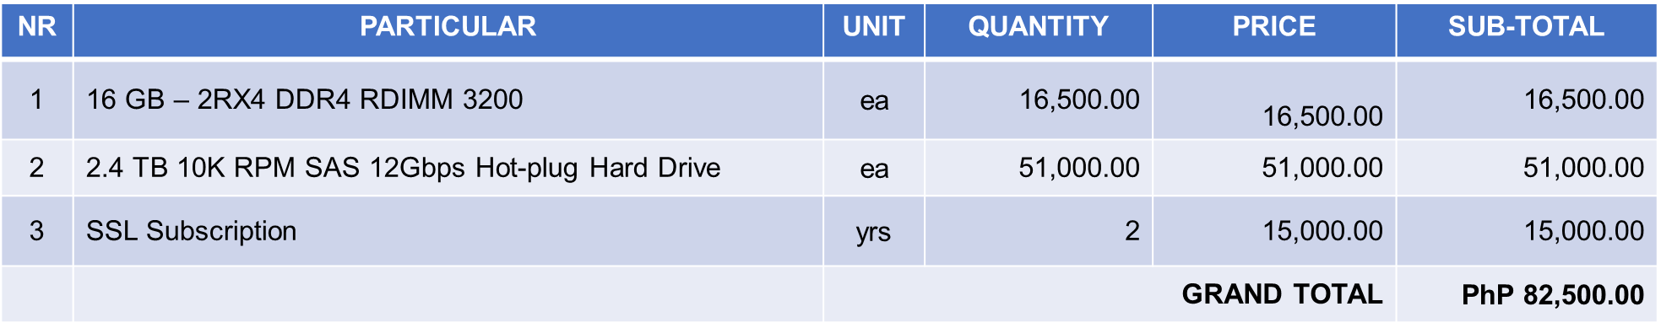
POE
Notes:
As shown is the proposed POE

Slide 11
RECOMMENDATION
Approval of the proposed POE for the development of the Automated QRS.

Slide 12

END OF
PRESENTATION

Slide 13
OPEN FORUM

Slide 14
END OF
PRESENTATION

